Slide 1
Problem solving with percentages and proportionality
Understanding multiplicative relationships: percentages and proportionality

Slide 2
how to use Oak lessons

Slide 3
I can use my knowledge of percentages and proportionality to solve problems.

Slide 4
Proportion is a part to whole (sometimes part to part) comparison. If two things are proportional then the ratio of part to whole is maintained and the multiplicative relationship between parts is also maintained.

Slide 5

Problem solving with percentages and proportionality
Using percentages to solve problems
Using proportionality to solve problems

Slide 6
Using percentages to solve problems
This shape represents part of a different shape.
What might the whole shape look like?
25%

Slide 7


Using percentages to solve problems
Here are Aisha and Jun’s shapes.
25%
Jun
Aisha
Have they both drawn a correct shape?
No, Aisha’s shape is correct but Jun’s shape represents 125% as he has used 5 triangles.

Slide 8
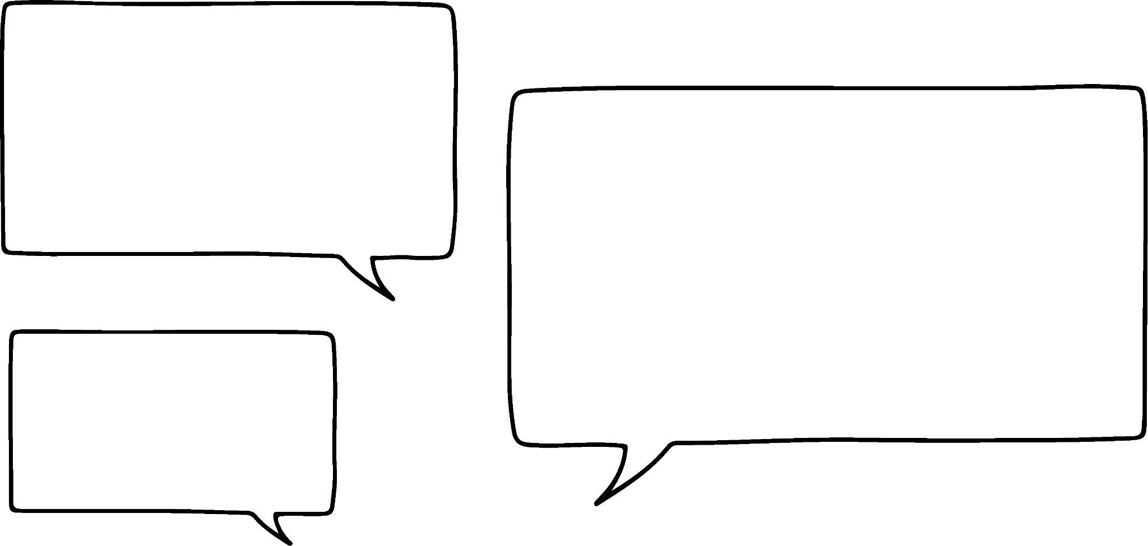
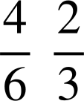
Using percentages to solve problems
This shape represents part of a different shape.
What might the whole shape look like?
60%
Of course. We could split the rectangle into six equal parts. Each part will be 10%. Then we need 1 whole rectangle and of another.
This one will not work. Because if I put 2 together that will be 120% and we need to sum to 100%.
Or, split the rectangle into 3 equal parts. Each part will be 20%. So, we need 1 whole rectangle and of another.
Aisha, we could use fractions of the shape.
Aisha
Jun

Slide 9
Using percentages to solve problems
We will use Jun’s idea. But, only because it means splitting the rectangle into fewer parts.
60%
60%
20%
20%
20%
40%
40%

Slide 10
Using percentages to solve problems
This shape represents part of a different shape.
What might the whole shape look like?
125%
Will the whole shape be bigger or smaller than this shape?
The original shape must be smaller, as it will be representing 100%.
How many parts should we split the shape into?
If we split it into 5 parts each part will represent 25%, and we would need to put 4 together to make the original shape.

Slide 11
Using percentages to solve problems
Split the shape into 5 equal parts.
Each part represents 25%.
25%
How many parts do we need to put together to make the original shape?
25% × 4 = 100%

Slide 12

Using percentages to solve problems
Which of the following would be a correct method for this shape?
180%
÷ 10 × 18
÷ 18 × 10
÷ 9 × 5
÷ 180 × 100

Slide 13

Using percentages to solve problems
Aisha watched a TV program in which they buy items, mend or fix them and then sell the items.
She is going to calculate the percentage profit or loss.
total spent
% | £
100 | 80
 | 120
% | £
100 | 80
150 | 120
× 1.5
× 1.5
Bought for £50
Cost to fix £30
Selling price £120
The change in percentage is 50%.
Therefore, they made 50% profit.

Slide 14
Using percentages to solve problems
Spot the mistake.
The cost of a house decreases from £260 000 to £252 200
What is the percentage decrease in price?
% | Cost (£)
100 | 260 000
97 | 252 200
× 0.97
× 0.97
The percentage decrease is 97%.
The percentage decrease is 3%. You need to consider the difference in the percentages. 100% − 97% = 3%.

Slide 15
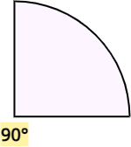
Using percentages to solve problems
1) The images below show some parts of different shapes.
What might each whole shape look like?
a)
e)
b)
f)
c)
g)
d)
h)
25%
70%
20%
10%
60%
5%
150%
120%

Slide 16
Using percentages to solve problems
2) Aisha watched a TV program in which they buy items, mend or fix them and then sell the items.
She is going to rank the items based on their percentage profit or loss.
Item bought | Cost to buy (£) | Other costs (£) | Selling price (£) | profit/loss | % change
Vase | 42 | 3 | 42.75
Watch | 75 | 10 | 93.50
Toy | 12 | 6 | 20.70
Painting | 38 | 17 | 50.60
Chair | 20 | 50 | 59.50
Necklace | 8 | 0 | 9.92

Slide 17
Using percentages to solve problems
1) The images below show some parts of different shapes.
What might each whole shape look like?
a)
25%
e.g.
25%

Slide 18
Using percentages to solve problems
1) The images below show some parts of different shapes.
What might each whole shape look like?
b)
70%
e.g.
70%
30%

Slide 19
Using percentages to solve problems
1) The images below show some parts of different shapes.
What might each whole shape look like?
c)
20%
e.g.
20%

Slide 20
Using percentages to solve problems
1) The images below show some parts of different shapes.
What might each whole shape look like?
d)
10%
e.g.
10%

Slide 21
Using percentages to solve problems
1) The images below show some parts of different shapes.
What might each whole shape look like?
e)
60%
e.g.
60%

Slide 22
Using percentages to solve problems
1) The images below show some parts of different shapes.
What might each whole shape look like?
f)
e.g.
5%

Slide 23

Using percentages to solve problems
1) The images below show some parts of different shapes.
What might each whole shape look like?
g)
e.g.
120%
of the original shape

Slide 24

Using percentages to solve problems
1) The images below show some parts of different shapes.
What might each whole shape look like?
h)
150%
e.g.
of the original shape

Slide 25
Using percentages to solve problems
2) Aisha watched a TV program in which they buy items, mend or fix them and then sell the items.
She is going to rank the items based on their percentage profit or loss.
Item bought | Cost to buy (£) | Other costs (£) | Selling price (£) | profit/loss | % change
Vase | 42 | 3 | 42.75 | loss | 5
Watch | 75 | 10 | 93.50 | profit | 10
Toy | 12 | 6 | 20.70 | profit | 15
Painting | 38 | 17 | 50.60 | loss | 8
Chair | 20 | 50 | 59.50 | loss | 15
Necklace | 8 | 0 | 9.92 | profit | 24
Order: chair, painting, vase, watch, toy, necklace

Slide 26
Problem solving with percentages and proportionality
Using percentages to solve problems
Using proportionality to solve problems

Slide 27

Using proportionality to solve problems
A bag of sweets contains red, yellow, pink and green sweets.
There are 48 sweets in the bag.
25% of them are red.
of them are yellow.
The rest are pink and green in the ratio 7 : 2
How many of each colour are there?
Red = 0.25 × 48
= 12
Yellow = × 48
= 18
Pink & green = 48 − (12 + 18)
= 18
pink | green | total
7 | 2 | 9
pink | green | total
7 | 2 | 9
 |  | 18
pink | green | total
7 | 2 | 9
14 | 4 | 18
There are 12 red, 18 yellow, 14 pink and 4 green sweets in the bag.
× 2

Slide 28

Using proportionality to solve problems
Andeep, Sofia and Jacob record how long it takes them to complete a puzzle.
Jacob’s time is four-fifths of Andeep’s time.
Andeep’s time is 5 times Sofia’s time.
The total of Andeep & Sofia’s times is 54 seconds.
What is the difference between Sofia and Jacob’s times?
Andeep | Sofia | total
5 | 1 | 6
45 | 9 | 54
Andeep | Sofia | total
5 | 1 | 6
 |  | 54
Andeep | Sofia | total
5 | 1 | 6
Jacob = × 45
× 9
= 36
The difference between Sofia (9) and Jacob (36) is 27 seconds.

Slide 29

Using proportionality to solve problems
A, B and C are 3 different numbers.
C is three-quarters of B
C is 5 times A
The total of A & C is 144
Find the value of B.
A | C | total
1 | 5 | 6
24 | 120 | 144
× 24
120 = × B
B = 120 ÷
B = 160

Slide 30
Using proportionality to solve problems
A, B and C are 3 different numbers.
C is three-quarters of B
C is 5 times A
The total of A & C is 144
Find the value of B.
A, B and C are 3 different numbers.
C is two-thirds of B
C is 4 times A
The total of A & C is 140
Find the value of B.
A | C | total
1 | 5 | 6
24 | 120 | 144
A | C | total
1 | 4 | 5
28 | 112 | 140
× 24
× 28
120 = × B
112 = × B
B = 120 ÷
B = 112 ÷
B = 160
B = 168

Slide 31

Using proportionality to solve problems
1) A bag of sweets contains red, yellow, pink and green sweets.
There are 56 sweets in the bag.
25% of them are red.
of them are yellow.
The rest are pink and green in the ratio 5 : 8
How many of each colour are there?

Slide 32

Using proportionality to solve problems
2) Aisha, Jun, Izzy, Sam and Laura raise money by doing a sponsored run.
They raise £600, Aisha raised 15%, Jun raised , and Izzy raised of the total.
Sam and Laura collected the rest in the ratio 2 : 3
How much money did each of them raise?

Slide 33
Using proportionality to solve problems
3) Andeep, Sofia and Jacob record how long it takes them to complete a puzzle.
Sofia’s time is two-thirds of Andeep’s time.
Jacob’s time is 3 times Sofia’s time.
The total of Jacob & Sofia’s times is 88 seconds.
What is the difference between Andeep and Jacob’s times?

Slide 34
Using proportionality to solve problems
1) A bag of sweets contains red, yellow, pink and green sweets.
There are 56 sweets in the bag.
25% of them are red.
of them are yellow.
The rest are pink and green in the ratio 5 : 8
How many of each colour are there?
Red = 14
Yellow = 16
Pink = 10
Green = 16

Slide 35
Using proportionality to solve problems
2) Aisha, Jun, Izzy, Sam and Laura raise money by doing a sponsored run.
They raise £600, Aisha raised 15%, Jun raised , and Izzy raised of the total.
Sam and Laura collected the rest in the ratio 2 : 3
How much money did each of them raise?
Aisha = £90
Jun = £160
Izzy = £225
Sam = £50
Laura = £75

Slide 36
Using proportionality to solve problems
3) Andeep, Sofia and Jacob record how long it takes them to complete a puzzle.
Sofia’s time is two-thirds of Andeep’s time.
Jacob’s time is 3 times Sofia’s time.
The total of Jacob & Sofia’s times is 88 seconds.
What is the difference between Andeep and Jacob’s times?
Andeep = 33 seconds
Sofia = 22 seconds
Jacob = 66 seconds
The difference between Andeep and Jacob’s times is is 33 seconds.

Slide 37
Problem solving with percentages and proportionality
You will often come across questions which involve fractions, percentages and ratio.
Drawing a diagram such as a bar model or double number line may help and using a ratio table to organise your working will keep errors to a minimum.
This is especially important if the question has lots of information. Writing down or drawing what you know using a representation can help.

Slide 38

© Oak National Academy 2024.
Produced in partnership with Mathematics in Education and Industry.
Licensed on the Open Government Licence v3.0, except where otherwise stated. See Oak terms and conditions.

